Slide 1
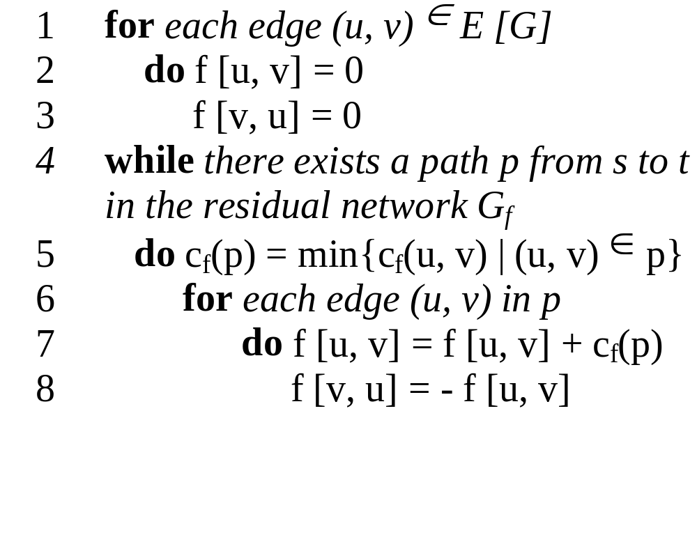
The basic Ford Fulkerson algorithm example of an execution
(residual) network G_{f}
v1
12
v3
16
20
10
4
7
S
9
t
4
13
v2
v4
14

Slide 2
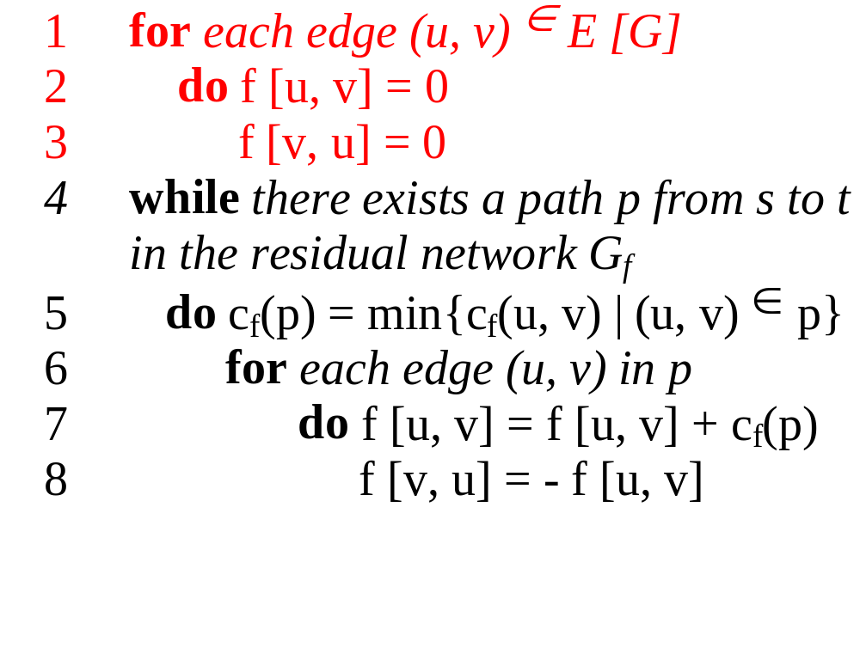
The basic Ford Fulkerson algorithm example of an execution
(residual) network G_{f}
v1
0/12
v3
0/16
0/20
0/10
0/4
7
S
0/9
t
0/4
0/13
v2
v4
0/14

Slide 3
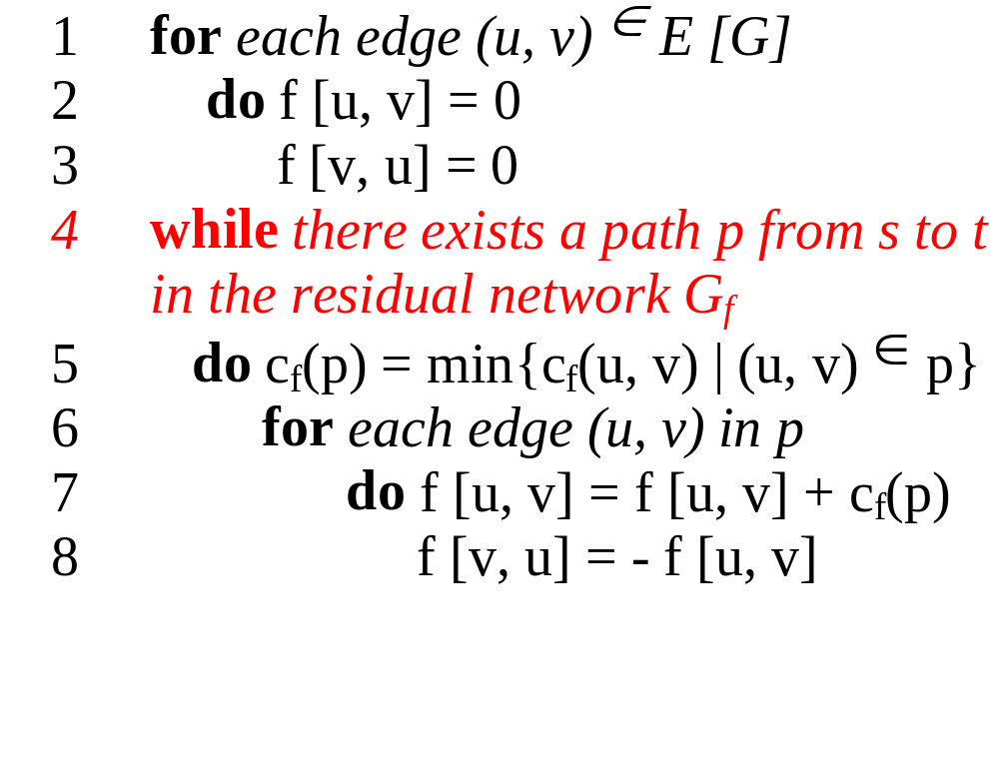
The basic Ford Fulkerson algorithm example of an execution
(residual) network G_{f}
v1
12
v3
16
20
10
4
7
S
9
t
4
13
v2
v4
14

Slide 4
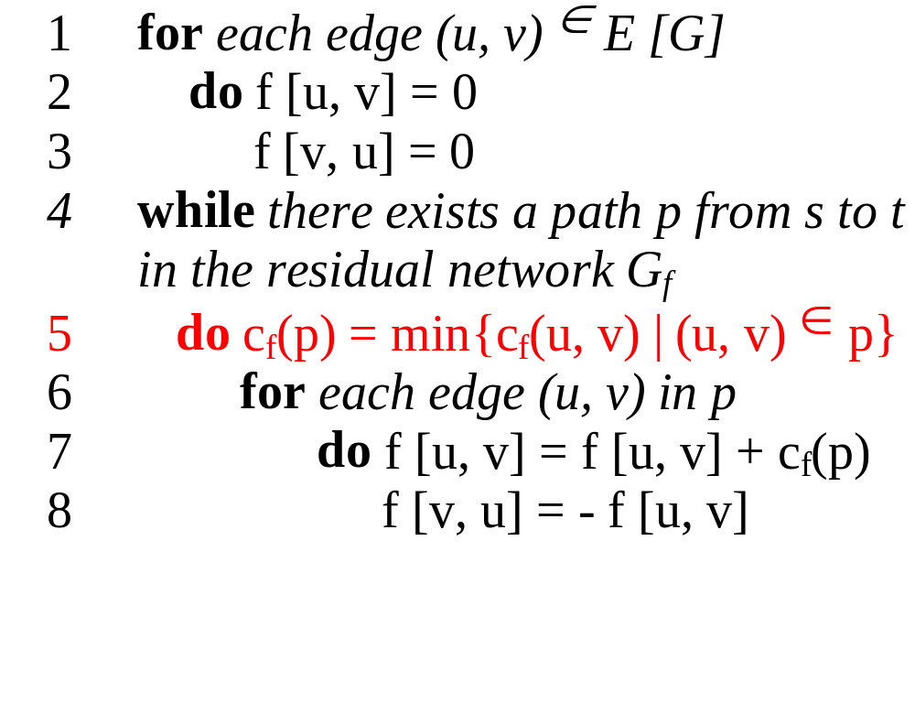
The basic Ford Fulkerson algorithm example of an execution
(residual) network G_{f}
v1
12
v3
16
20
10
4
7
S
9
t
4
13
v2
v4
14
temporary variable:
c_{f} (p) = 12

Slide 5
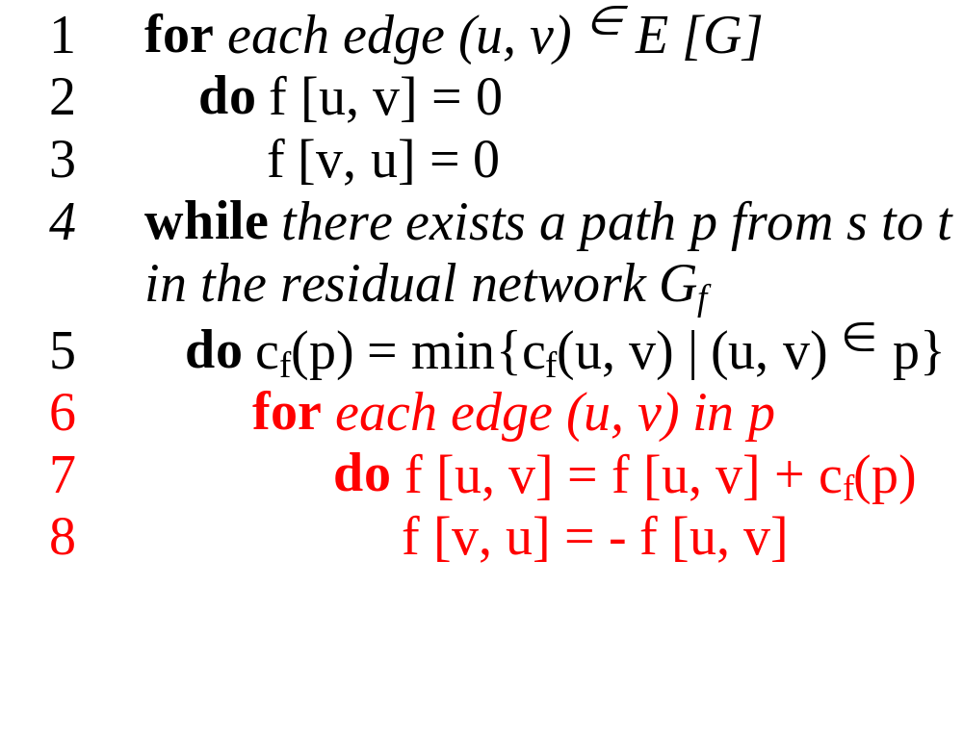
The basic Ford Fulkerson algorithm example of an execution
(residual) network G_{f}
v1
12
v3
16
20
10
4
7
S
9
t
4
13
v2
v4
14
new flow network G
v1
12/12
v3
12/16
12/20
temporary variable:
c_{f} (p) = 12
10
4
7
S
9
t
4
13
v2
v4
14

Slide 6
The basic Ford Fulkerson algorithm example of an execution
(residual) network G_{f}
v1
12
v3
4
8
12
12
10
4
7
S
9
t
4
13
v2
v4
14
new flow network G
v1
12/12
v3
12/16
12/20
10
4
7
S
9
t
4
13
v2
v4
14

Slide 7
The basic Ford Fulkerson algorithm example of an execution
(residual) network G_{f}
v1
12
v3
4
8
12
12
10
4
7
S
9
t
4
13
v2
v4
14
new flow network G
v1
12/12
v3
12/16
12/20
10
4
7
S
9
t
4
13
v2
v4
14

Slide 8
The basic Ford Fulkerson algorithm example of an execution
(residual) network G_{f}
v1
12
v3
4
8
12
12
10
4
7
S
9
t
4
13
v2
v4
14
new flow network G
v1
12/12
v3
12/16
12/20
10
4
7
S
9
t
4
13
v2
v4
14

Slide 9
The basic Ford Fulkerson algorithm example of an execution
(residual) network G_{f}
v1
12
v3
4
8
12
12
10
4
7
S
9
t
4
13
v2
v4
14
new flow network G
v1
12/12
v3
12/16
12/20
10
4
7
S
9
t
temporary variable:
c_{f} (p) = 4
4
13
v2
v4
14

Slide 10
The basic Ford Fulkerson algorithm example of an execution
(residual) network G_{f}
v1
12
v3
4
8
12
12
10
4
7
S
9
t
4
13
v2
v4
14
new flow network G
v1
12/12
v3
12/16
12/20
temporary variable:
c_{f} (p) = 4
10
4
7
S
9
t
4/4
4/13
v2
v4
4/14

Slide 11
The basic Ford Fulkerson algorithm example of an execution
(residual) network G_{f}
v1
12
v3
4
8
12
12
10
4
7
S
9
t
4
4
4
9
v2
v4
10
new flow network G
v1
12/12
v3
12/16
12/20
10
4
7
S
9
t
4/4
4/13
v2
v4
4/14

Slide 12
The basic Ford Fulkerson algorithm example of an execution
(residual) network G_{f}
v1
12
v3
4
8
12
12
10
4
7
S
9
t
4
4
4
9
v2
v4
10
new flow network G
v1
12/12
v3
12/16
12/20
10
4
7
S
9
t
4/4
4/13
v2
v4
4/14

Slide 13
The basic Ford Fulkerson algorithm example of an execution
(residual) network G_{f}
v1
12
v3
4
8
12
12
10
4
7
S
9
t
4
4
4
9
v2
v4
10
new flow network G
v1
12/12
v3
12/16
12/20
10
4
7
S
9
t
4/4
4/13
v2
v4
4/14

Slide 14
The basic Ford Fulkerson algorithm example of an execution
(residual) network G_{f}
v1
12
v3
4
8
12
12
10
4
7
S
9
t
4
4
4
9
v2
v4
10
new flow network G
v1
12/12
v3
12/16
12/20
temporary variable:
c_{f} (p) = 7
10
4
7
S
9
t
4/4
4/13
v2
v4
4/14

Slide 15
The basic Ford Fulkerson algorithm example of an execution
(residual) network G_{f}
v1
12
v3
4
8
12
12
10
4
7
S
9
t
4
4
4
9
v2
v4
10
new flow network G
v1
12/12
v3
12/16
19/20
temporary variable:
c_{f} (p) = 7
10
4
7/7
S
9
t
4/4
11/13
v2
v4
11/14

Slide 16
The basic Ford Fulkerson algorithm example of an execution
(residual) network G_{f}
v1
12
v3
4
1
12
19
10
4
7
S
9
t
11
11
4
2
v2
v4
3
new flow network G
v1
12/12
v3
12/16
19/20
10
4
7/7
S
9
t
4/4
11/13
v2
v4
11/14

Slide 17
The basic Ford Fulkerson algorithm example of an execution
(residual) network G_{f}
v1
12
v3
4
1
12
19
10
4
7
S
9
t
11
11
4
2
v2
v4
3
new flow network G
v1
12/12
v3
12/16
19/20
10
4
7/7
Finally we have:
| f | = f (s, V) = 23
S
9
t
4/4
11/13
v2
v4
11/14

Slide 18
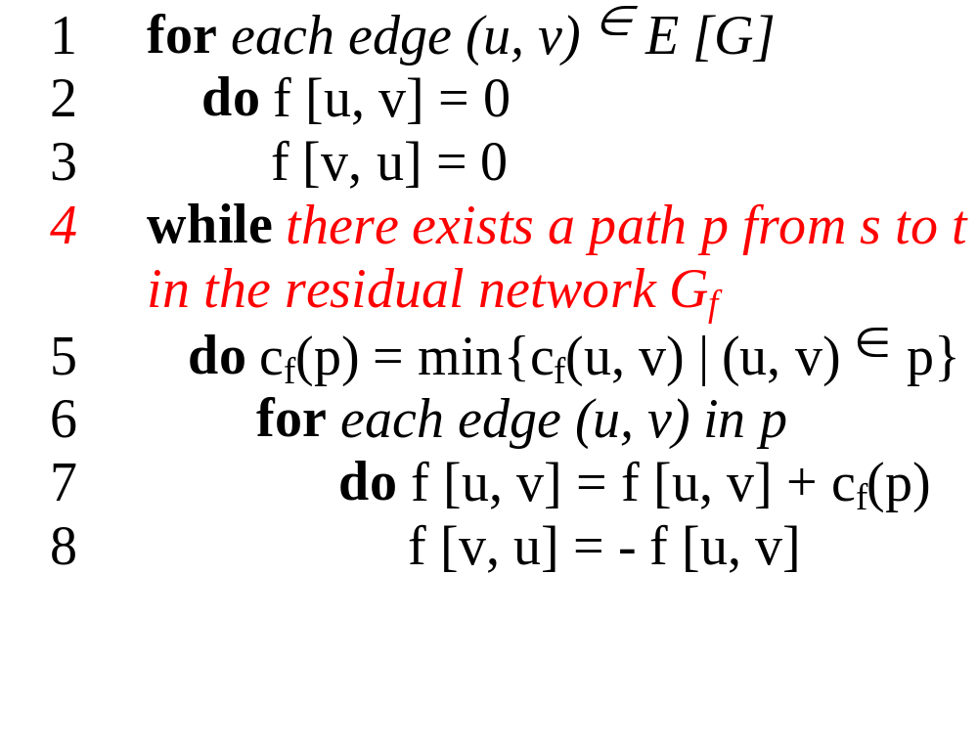
Analysis of the Ford Fulkerson algorithm
Running time
The running time depends on how the augmenting path p in line 4 is determined.

Slide 19

Analysis of the Ford Fulkerson algorithm
Running time (arbitrary choice of p)
O(|E|)
O(|E|)
O(|E| |f_{max}|)
O(|E|)
running time: O ( |E| |f_{max}| )
with f_{max} as maximum flow
(1) The augmenting path is chosen arbitrarily and all capacities are integers
Notes:
breath first search or depth first search

Slide 20
Analysis of the Ford Fulkerson algorithm
Running time (arbitrary choice of p)
Consequencies of an arbitrarily choice:
Example if |f*| is large:
v1
1,000,000
1,000,000
s
1
t
1,000,000
1,000,000
v2
running time: O ( |E| |f_{max}| )
with f_{max} as maximum flow
(1) The augmenting path is chosen arbitrarily and all capacities are integers

Slide 21
Analysis of the Ford Fulkerson algorithm
Running time (arbitrary choice of p)
Consequencies of an arbitrarily choice:
Example if |f*| is large:
residual network G_{f}
v1
v1
1 / 1,000,000
1,000,000
999,999
1,000,000
1
s
1 / 1
t
s
1
t
1
1,000,000
1 / 1,000,000
1,000,000
999,999
v2
v2
running time: O ( |E| |f_{max}| )
with f_{max} as maximum flow
(1) The augmenting path is chosen arbitrarily and all capacities are integers

Slide 22
Analysis of the Ford Fulkerson algorithm
Running time (arbitrary choice of p)
Consequencies of an arbitrarily choice:
Example if |f*| is large:
residual network G_{f}
v1
v1
1 / 1,000,000
1 / 1,000,000
999,999
999,999
1
1
s
1
t
s
1
t
1
1
1 / 1,000,000
1 / 1,000,000
999,999
999,999
v2
v2
running time: O ( |E| |f_{max}| )
with f_{max} as maximum flow
(1) The augmenting path is chosen arbitrarily and all capacities are integers

Slide 23
Analysis of the Ford Fulkerson algorithm
Running time with Edmonds-Karp algorithm
Informal idea of the proof:
for all vertices v ∈ V\{s,t}:
the shortest path distance δ_{f}(s,v) in G_{f} increases monotonically with each flow augmentation
δ_{f} (s,v) < δ_{f´} (s,v)
u1
4
v3
6
6
2
2
S
t
4
4
u2
v4
4
running time: O ( |V| |E|² )
(2) Edmonds-Karp algorithm
augmenting path is found by breath-first search and has to be a shortest path from p to t
Notes:
unit distances

Slide 24
Analysis of the Ford Fulkerson algorithm
Running time with Edmonds-Karp algorithm
Informal idea of the proof:
for all vertices v ∈ V\{s,t}:
the shortest path distance δ_{f}(s,v) in G_{f} increases monotonically with each flow augmentation
. δ_{f}(s,v) < δ_{f´}(s,v)
u1
4
v3
6
6
2
2
S
t
4
4
u2
v4
4
δ_{f}(s,u2) = 1
running time: O ( |V| |E|² )
(2) Edmonds-Karp algorithm
augmenting path is found by breath-first search and has to be a shortest path from p to t

Slide 25
Analysis of the Ford Fulkerson algorithm
Running time with Edmonds-Karp algorithm
Informal idea of the proof:
for all vertices v ∈ V\{s,t}:
the shortest path distance δ_{f}(s,v) in G_{f} increases monotonically with each flow augmentation
. δ_{f}(s,v) < δ_{f´}(s,v)
Two flow augmentations later
u1
4
v3
4
4
2
2
2
2
S
t
4
4
u2
v4
4
δ_{f}(s,u2) = 3
running time: O ( |V| |E|² )
(2) Edmonds-Karp algorithm
augmenting path is found by breath-first search and has to be a shortest path from p to t

Slide 26
Analysis of the Ford Fulkerson algorithm
Running time with Edmonds-Karp algorithm
The total number of flow augmentations performed by the algorithm is at most O(|V| |E|)
u1
4
v3
6
6
2
2
S
t
4
4
u2
v4
4
running time: O ( |V| |E|² )
(2) Edmonds-Karp algorithm
augmenting path is found by breath-first search and has to be a shortest path from p to t

Slide 27
Analysis of the Ford Fulkerson algorithm
Running time with Edmonds-Karp algorithm
Def: critical edge (u,v)
if c_{f}(p) = c_{f}(u,v)
At least one edge on p must be critical.
How many times can (u,v) be critical during an execution of Edmonds-Karp algorithm?
u1
4
v3
6
6
2
2
S
t
4
4
u2
v4
4
Critical edges on the path p
running time: O ( |V| |E|² )
(2) Edmonds-Karp algorithm
augmenting path is found by breath-first search and has to be a shortest path from p to t

Slide 28
Analysis of the Ford Fulkerson algorithm
Running time with Edmonds-Karp algorithm
Idea:
(u,v) can become critical at most O(V) times
(After beeing critical it dissappears in G_{f} and can only reappear after net flow is decreased)
u1
4
v3
6
6
2
2
S
t
4
4
u2
v4
4
our example: edge (u2,v4)
running time: O ( |V| |E|² )
(2) Edmonds-Karp algorithm
augmenting path is found by breath-first search and has to be a shortest path from p to t

Slide 29
Analysis of the Ford Fulkerson algorithm
Running time with Edmonds-Karp algorithm
Idea:
(u,v) can become critical at most O(V) times
(After beeing critical it dissappears in G_{f} and can only reappear after net flow is decreased)
Two flow augmentations later
u1
4
v3
4
4
2
2
2
2
S
t
4
4
u2
v4
4
our example: edge (u2,v4) has disappeared
running time: O ( |V| |E|² )
(2) Edmonds-Karp algorithm
augmenting path is found by breath-first search and has to be a shortest path from p to t

Slide 30
Analysis of the Ford Fulkerson algorithm
Running time with Edmonds-Karp algorithm
Idea:
(u,v) can become critical at most O(V) times
(After beeing critical it disappears in G_{f} and can only reappear after net flow is decreased)
After the third flow augmentation
u1
4
v3
6
6
2
2
S
t
2
4
4
u2
v4
2
our example: edge (u2,v4) reappeared but is now unreachable from s
running time: O ( |V| |E|² )
(2) Edmonds-Karp algorithm
augmenting path is found by breath-first search and has to be a shortest path from p to t

Slide 31
Analysis of the Ford Fulkerson algorithm
Running time with Edmonds-Karp algorithm
Idea:
(u,v) can become critical at most O(|V|) times
O(|E|) pairs of vertices exist in Gf
All critical edges in O(|V| |E|)
O(|E|) for breath first search for p
total running time O(|V| |E|²)
running time: O ( |V| |E|² )
(2) Edmonds-Karp algorithm
augmenting path is found by breath-first search and has to be a shortest path from p to t
Notes:
u can only have a maximum distance from s of O(|V|) therefore (u,v) can become critical at most O(|V|) times

